Slide 1
Pdn:
*Prepare your 3 talking points per item of discussion for the day.

Slide 2
What offends you?
What is now socially acceptable? Are people entitled to an opinion without persecution?

Slide 3
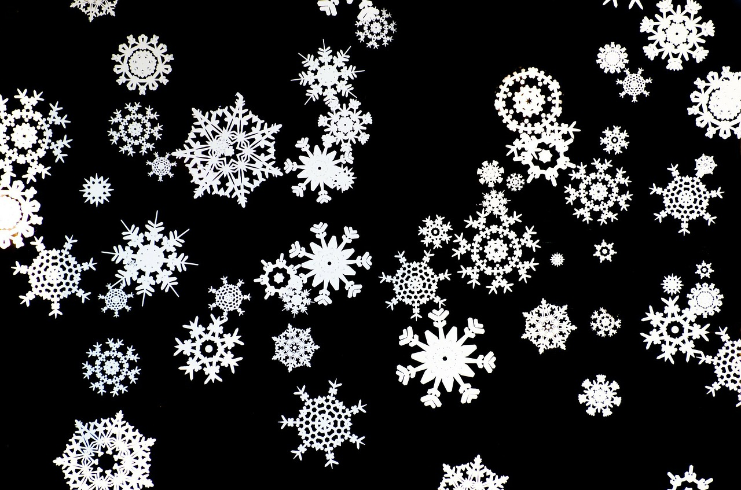
People are too easily offended.
The term snowflake comes to mind.
People should mind their own business?

Slide 4
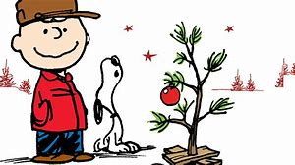
Charlie brown’s Christmas & Thanksgiving special should be banned from tv?
Promotes segregation and racism?

Slide 5
Baby its cold outside should no longer be played on the radio?
Promotes a sexist view of our world dating all the way back to 1944.
It also is said to promote the “date rape” culture.

Slide 6
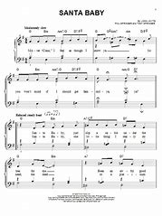
Santa baby should no longer be a promoted song?
Promotes the demoralization of women.
Seen as raunchy & superficial & portrays Santa as a “sugar daddy”.

Slide 7
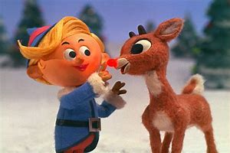
Rudolph the red nosed reindeer should be stricken from the holiday tv lineup?
Promotes bullying & verbal abuse.
“Sociopathic Tendencies”

Slide 8
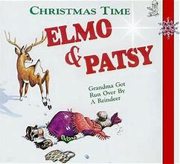
Grandma got run over by a reindeer should not be played at all?
Promotes a disrespectful and callous nature towards people.

Slide 9
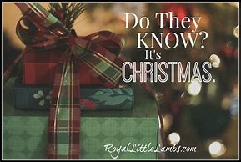
Do they know its Christmas needs to be reworded.
It’s too patronizing.
The lyrics are also seen as promoting a “white savior” complex.

Slide 10
Deck the halls is sending the wrong message about the holidays.
Promoting the “gay agenda” & homophobia as a result.

Slide 11
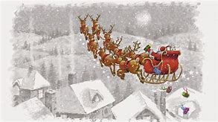
The song white Christmas needs to be banned.
Promotes white supremacy.

Slide 12
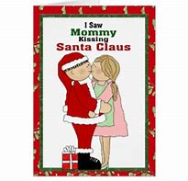
I saw mommy kissing santa claus is giving our kids a horrible message.
Promotes infidelity
Promotes underage incestuous voyeurism.

Slide 13
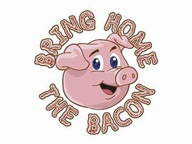
Bring home the bacon needs to be used no more in the English language?
It offends helpless piggies.

Slide 14
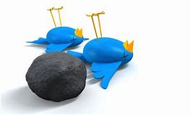
Kill two birds with one stone needs to be replaced with something more appealing?
We shouldn’t promote the killing of helpless birdies.

Slide 15
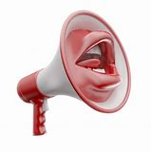
People should be permitted to say whatever holiday greeting they so choose?
Merry Christmas, Happy Hanukkah, Happy Holidays, Happy Kwanzaa and Happy New Year, just to name a few.

Slide 16
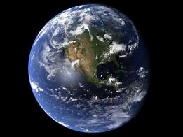
The earth is round!
Change my mind!

Slide 17
There are only 2 genders?
What else could there possibly be?

Slide 18
People are way too sensitive!
A scene from the movie Elf was cut from TV due to gender issues.

Slide 19
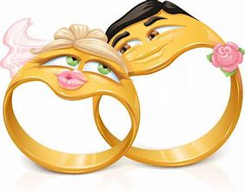
It’s okay for a wife to leave her husband but not for a husband to leave his wife?
Double standard?

Slide 20
People should not have to vaccinate their children if they so choose.
They pose no risk to those around them.
They run no more of a risk than any other child.

Slide 21
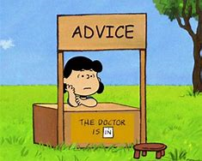
People all too freely offer their unwanted advice!
Privacy is necessary.

Slide 22
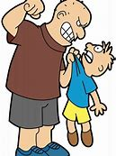
Despite our best efforts bullying & harassment is not getting any better?
Too much damage is already done.

Slide 23
Social media is the downfall of our society!
People cannot think for themselves!

Slide 24
*you are now required to complete a 1 page essay on a topic of your choosing that we have discussed today. You will either show approval or disapproval for that topic and support that stance within your writing.

